Slide 1
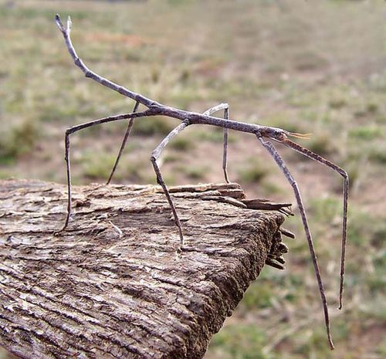
All About Stick Insects

Slide 2
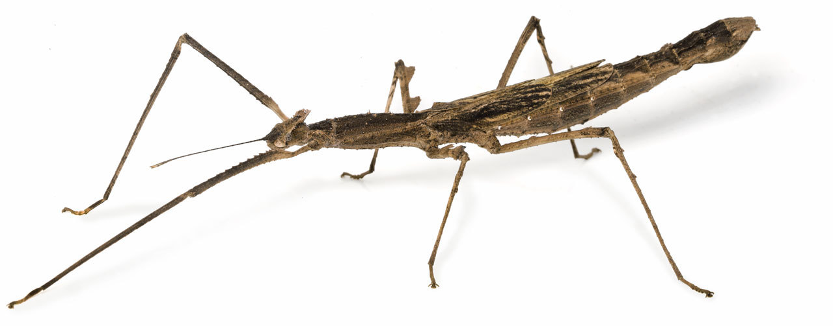
Stick insects are insects. They have six legs

Slide 3
Stick insects live in trees.

Slide 4
Stick insects eat leaves from the trees.

Slide 5
Stick insects are camouflage insects.

