Slide 1
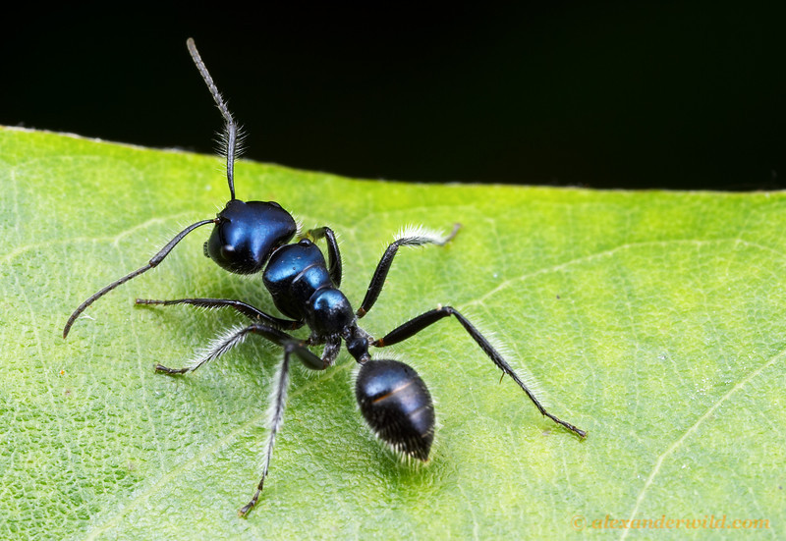
AII About Ants

Slide 2
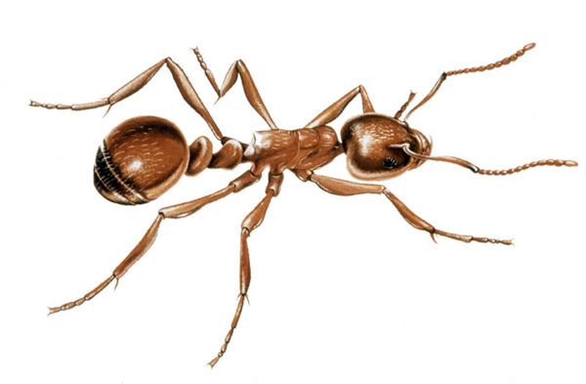
Ants are insects. They have six legs.

Slide 3
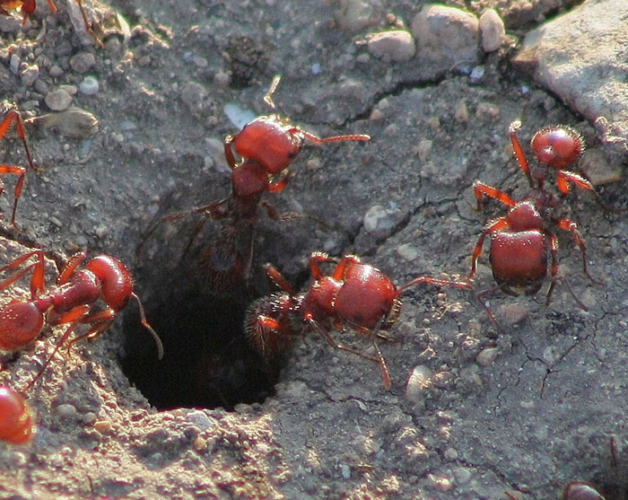
Ants live in the ground.

